Slide 1
High-level layout-to-code generation 2015-09-13 major update
Yu-Jiu Wang

Slide 2
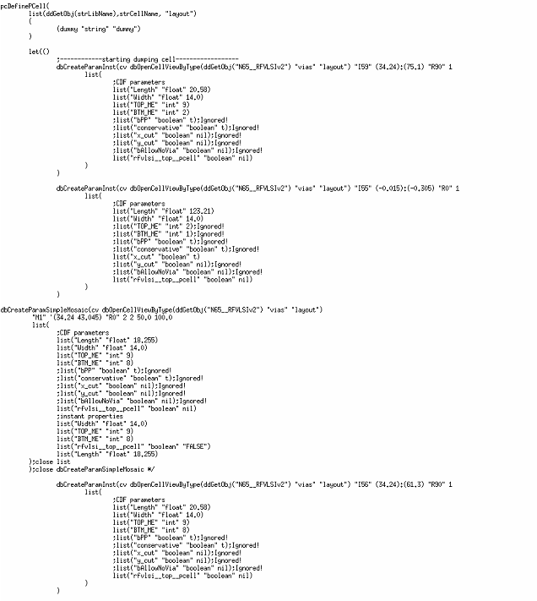
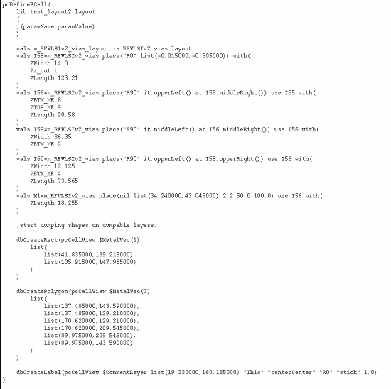
Low-level v.s. High-level code-generation:

Slide 3
Which parts are high-level??
Take advantage of the RFSKILL codes:
Automatic finding handles that attach each other.
Automatic finding placed instance to reuse parameters.
Automatic extracting “process-independent” codes, given the layout is process-dependent.
list(“M1”,”drawing”)=> MetalVec(1)
list(“text”,”drawing”)=>$CommentLayer

Slide 4
RF-Skill Language feature improvements.
The cadence skill doesn’t support function cascading, such as this style:
lab.getPerson(“Roger”).getDataSet(“exp1”).findValidData().sum()
In order to support the above OOP programming style, (which is necessary for complex code), a strict type-checking is required; which means that we need to check what is returned, and furthered processed along the code.
lab.getPerson(“Roger”) ➔ returns an object of Person
Person.getDataSet()➔ returns a Set of Data
Data.findValidData()➔ returns a valid data among the same
Data.sum() ➔ returns a numerical data.
A partial of strict-type-checking is implemented in our current RF-Skill language. (Only the part that is sufficient for me to finish the complex codes in a week; instead of month.) I will implement the complete type check when I have time.

Slide 5
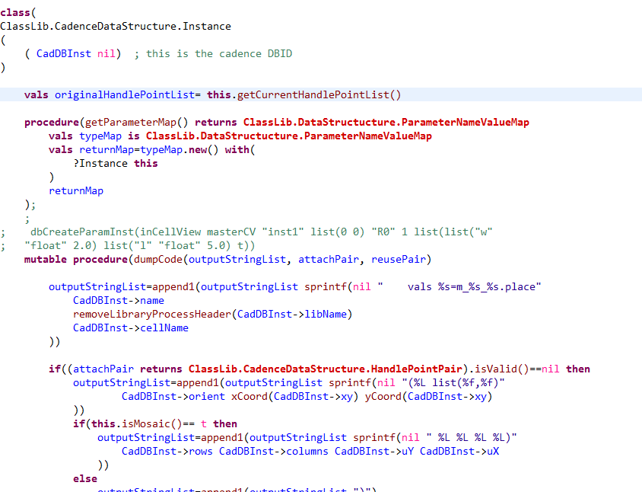
Now Language feature:
This part is equal to C++/Java Constructor.
Take advantage of PCELL style.
Class definition:
This part consists of functions.
Note: a class follows typical state-machine model mutability. (re-assignement is OK).

Slide 6
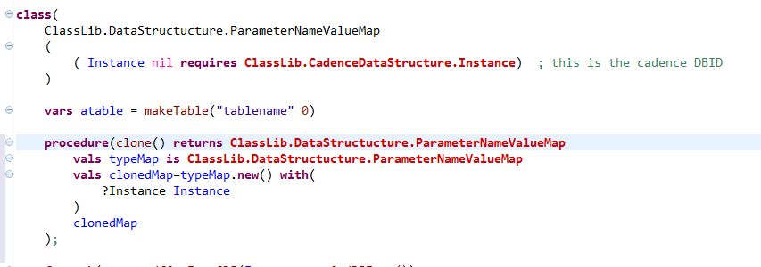
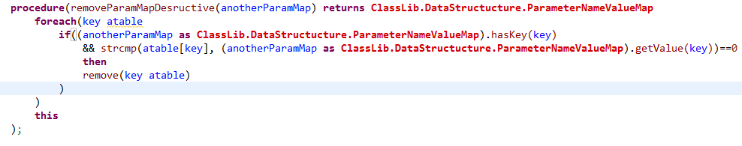
Type information for strict type-checking keywords: 1. requires, 2. returns, 3. as
Requires specifies the type of the input parameter
returns specifies a function’ return type.
as specifies a symbol’s type; if it cannot be inferred.

Slide 7
Object generation: new() instead of place()
New() an instance of a class, instead of using place() for a pcDefinePCell().
We strictly force this (otherwise, an error will be given in IDE) to maintain the safety between 1. our physical designs, and 2. complex logical programming (such as high-level code-generations.

Slide 8
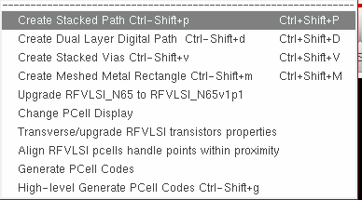
The usage:
After load(“~/src-gen-cadence-loading/N65/allRunTime.il”)
Use the manu:
Generate Pcell Codes keep old code generation for a while for debugging purpose.
The new High-level generate pcell codes dump codes to cadence console; with debugging info on the front.
Note, the Align instances functions are improved using the new language feature to allow readable codes/ and better debugging.

Slide 9
The best practices updated!
Use “RF-SKill” generated Pcell as many as possible.
Quick Placement of Pcell Instances manually.
Align using auto-alignment to align instances in your layout.
Dump high-level pcell code, and make your layout general by adding parameters.
Regenerate your layout back to cadence/allegro/HFSS.. Etc.

